Slide 1

CSCI 4502/5502
Data Mining - Fall 2023 - Lecture 11
Ravi Starzl, PhD

Slide 2
1
Basic Concepts
Classification: Basic Concepts
2
Decision Tree Induction
3
Bayesian classification
4
Rule-based classification
5
Model evaluation and selection
6
Improve classification
accuracy
Ravi Starzl, PhD - Data Mining Fall 2023
Notes:
Classification is a form of supervised learning. In this approach, models are trained using a dataset that has predetermined outcomes. This training enables the model to forecast outcomes for data it has not seen before.
Classification fundamentally consists of two phases: model construction and the classification itself. The model construction phase involves training the model using known data. The subsequent classification phase then utilizes this trained model to identify the class of unfamiliar data.
Decision tree induction is a method of classification. A decision tree, as implied by its name, is a tree-like structure used for decision-making purposes. This tree can be likened to a flowchart. Each internal node of the tree represents a test on a particular attribute, the branches indicate the outcome of that test, and the leaf or terminal nodes carry a class label. The model makes determinations based on these test outcomes. Procedures for building and employing a decision tree for classification tasks will be covered.
Another significant classification technique is Bayesian classification. This method operates based on Bayes' theorem, a foundational principle in probability that articulates the interplay between the conditional probabilities of statistical values. Using Bayesian classification, it's possible to determine the likelihood of a label given certain observed attributes. This is achieved by utilizing known or computable probabilities.
Rule-based classification will also be addressed, which operates using IF-THEN rules. In these rules, the 'IF' segment stipulates the condition, and the 'THEN' segment delivers the conclusion. This system is straightforward and can be easily interpreted. Such classifiers are not dependent on preliminary probability estimates and are compatible with both numerical and categorical datasets.
Evaluating a model's efficacy is essential. Methods for model evaluation and selection will be presented. Various performance indicators, including precision, recall, F1 score, and accuracy, will be reviewed. Cross-validation is a method that provides insight into a model's capacity to generalize to data it hasn't encountered.
Strategies to enhance the accuracy of classification will also be explored. One such strategy is feature selection, which entails choosing the input variables that have the most relevance to the outcome being predicted. This selection process is vital for crafting a model that is both precise and efficient. Additionally, ensemble methods like bagging and boosting will be covered. These methods amalgamate predictions from several models to elevate overall prediction accuracy.

Slide 3

Classification vs. Prediction
Classification
determines categorical class labels
e.g., safe vs. risky; weather condition
Prediction
models continuous valued functions
Typical applications
loan approval, target marketing, medical diagnosis, fraud detection, etc.
Ravi Starzl, PhD - Data Mining Fall 2023
Notes:
Classification and prediction are two essential techniques in machine learning and data science. Recognizing the distinctions between these techniques helps in choosing the suitable method based on the data and the problem at hand.
Classification is a form of supervised learning where the outcome or dependent variable is categorical. In essence, it involves determining the class labels of unknown entities. An example includes a bank classifying loan applicants into categories such as 'safe' or 'risky'. In this context, 'safe' suggests the applicant has a high likelihood of repaying the loan, while 'risky' indicates a potential default risk. The result of classification isn't numerical but falls into a specific category or class label. Another instance is categorizing weather conditions as 'sunny', 'cloudy', 'rainy', or 'snowy' based on various atmospheric measures.
Prediction, also referred to as regression, deals with modeling continuous valued functions or ordered quantities. Instead of categorizing data, the goal is to estimate or forecast a specific value. A representative prediction problem is real estate price estimation. Here, features like location, number of rooms, property age, and other relevant factors are used to predict a house's price. The objective is to determine a continuous value based on input variables.
Examining typical applications, loan approval is a familiar classification problem. It involves categorizing loan applicants as 'approved' or 'denied' using features such as credit history, employment status, and income level. Classification also plays a role in target marketing. Businesses categorize customers based on buying behavior, preferences, and demographics. For instance, a retail entity might categorize customers as 'frequent buyers', 'occasional buyers', or 'rare buyers' to refine marketing strategies.
In healthcare, classification aids in medical diagnosis. Doctors and healthcare practitioners categorize patient data into labels like 'disease A', 'disease B', or 'healthy' using symptoms, test outcomes, and other medical information. Fraud detection is another area where classification is vital, distinguishing transactions as 'legitimate' or 'fraudulent' based on data patterns.
Regarding prediction, problems such as stock price forecasting come to the fore. The goal is to predict future stock values using historical data and market patterns. Another predictive application involves estimating a customer's lifetime value to a business, assisting in decisions related to customer retention and acquisition.
While classification and prediction may seem similar, they serve different purposes. Classification groups data into predefined categories, whereas prediction focuses on estimating continuous values. Both techniques find applications across various sectors, from finance to healthcare to marketing.

Slide 4
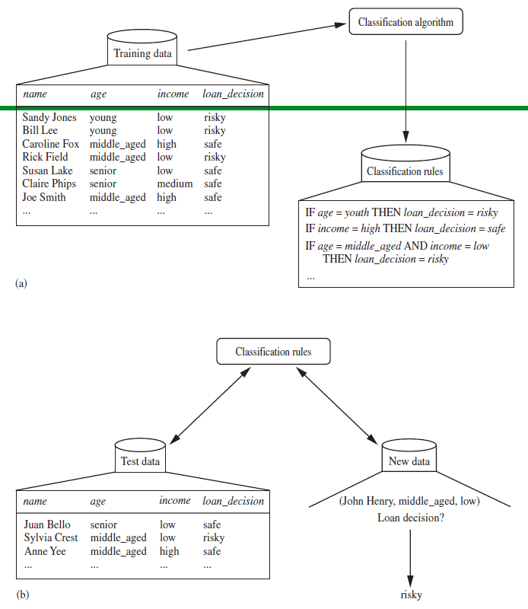
Classification vs. Prediction
Step 1: Learning
model construction
training set, class labels
Step 2: Classification
test set, accuracy
Ravi Starzl, PhD - Data Mining Fall 2023
Notes:
During the learning phase, also known as model construction, a training set comprising both features and class labels is utilized. Features represent the descriptive attributes or independent variables, for example, patient symptoms in a medical context. The class labels, or dependent variables, are the categories that are aimed to be predicted, such as potential diseases.
This training set undergoes processing by a classification algorithm. The objective here is to devise a model that aptly delineates the relationship between the features and class labels present in the training data. Different algorithms approach this task uniquely. For instance, while a decision tree algorithm might formulate a tree-based decision model, a support vector machine delineates hyperplanes in a multidimensional space to differentiate classes.
The subsequent phase is classification, wherein the developed model is subjected to a test set comprising known class labels. This step's primary aim is to gauge the model's accuracy, evaluating its capability to classify previously unseen data.
Consider a practical scenario involving emails labeled as 'spam' or 'not spam'. During the learning phase, a classification algorithm may pinpoint specific keywords recurrent in spam emails. Subsequently, this model, expressed as a set of rules, is employed during the classification phase to label incoming emails accordingly.
Visualization can aid in understanding this process. The initial visualization might depict the training data being processed by the classification algorithm, culminating in a set of rules. This can be imagined as a funnel, where the expansive spectrum of training data possibilities is condensed into a definitive set of rules. The succeeding visualization could represent the rule application to classify test and new data, akin to a language learner interpreting an unfamiliar text using acquired rules.
Model performance can be assessed using accuracy, which denotes the proportion of accurate predictions relative to all predictions. Although a direct and intuitive metric, accuracy may not always be the optimal performance measure, especially when handling datasets with imbalances.

Slide 5

Supervised vs. Unsupervised
Supervised learning (classification)
supervision: training data accompanied by class labels
new data is classified based on training set
Unsupervised learning (clustering)
class labels of training data is unknown
aims to establish the existence of classes or clusters in the data
Ravi Starzl, PhD - Data Mining Fall 2023
Notes:
Selecting a suitable learning model is a fundamental decision. Two primary types are supervised and unsupervised learning. The differentiation between these two lays the foundation for understanding classification, a category of supervised learning.
In supervised learning, the term "supervised" implies that the model undergoes guidance during its learning process. This guidance derives from training data paired with class labels. These labels act as an instructor, directing the model on the correct output for each input. An example is an email spam filter. Initially, this system is trained using emails labeled as 'spam' or 'not spam', allowing the model to discern patterns linked to each category. When the system encounters new data, like an incoming email, the spam filter can classify it based on the patterns learned from the training set. Thus, supervised learning is a mechanism for creating predictive models from labeled historical data.
Classification, a subset of supervised learning, is about predicting a class label. This process usually entails a function mapping input data (features) to an output value (class label). For instance, logistic regression, a prevalent classification method, employs the logistic function to render its output into a probability value, which can then be associated with multiple class labels.
Conversely, unsupervised learning, exemplified by clustering, allows the model to learn autonomously without class label guidance. The objective isn't to forecast a known result but to detect underlying structures in the data. Take, for instance, a comprehensive dataset from a retail company's customers. Unsupervised learning can identify groups or clusters of customers based on their purchasing behaviors without predefined categories.
Clustering aims to determine the presence of classes or clusters in data. For example, the K-means clustering algorithm divides data into K distinct clusters based on their attributes. The center of each cluster, or centroid, is computed as the mean of all its points. Each data point is then associated with the cluster whose centroid is nearest.
With supervised learning, there's a ground truth outcome based on labeled data. In unsupervised learning descriptive analysis and discovery is the goal, searching for new patterns or groupings in the dataset.

Slide 6

Issues: Evaluation Criteria
Accuracy: classification vs. prediction
Speed: time to construct / use the model
Robustness: handling noise & missing values
Scalability: large amounts of data
Interpretability: understanding and insight
Goodness of rules: e.g., decision tree size, compactness of classification rules
Ravi Starzl, PhD - Data Mining Fall 2023
Notes:
Key Elements when assessing the performance of a classification model:
1. Accuracy: This measures a model's capability to correctly classify or predict an outcome. It is defined as the ratio of correct predictions to all predictions made. It's important to differentiate between classification and prediction. While classification designates a label, prediction determines a numeric value. An example of classification would be determining if an email is spam, whereas estimating a stock market price represents prediction.
2. Speed: Efficiency in terms of time is significant both during model construction and its subsequent application. Constructing a model can involve training on extensive datasets, making computational efficiency essential. Moreover, the time taken by a model to predict outcomes on new data can directly influence user experience, especially in systems operating in real-time.
3. Robustness: A model's ability to effectively manage noise and missing data points is a testament to its robustness. Noise comprises random, inconsistent data points that might skew the overall data pattern. Addressing missing values, frequently found in practical data scenarios, often entails methods such as imputation, wherein absent values are substituted based on existing data values.
4. Scalability: With the advent and proliferation of big data, ensuring that a model can handle vast data volumes efficiently becomes paramount. This necessitates designing algorithms optimized for memory consumption and processing capabilities.
5. Interpretability: Beyond mere prediction, a model should facilitate understanding of inherent data patterns. An interpretable model offers insights and clarity, aiding decision-making processes. Decision trees, for instance, are popular due to their straightforward visual representation and comprehensibility.
6. Goodness of Rules: This aspect is quantified using metrics such as the size of a decision tree or the conciseness of classification rules. In the context of decision trees, a more concise tree is often favored for its clarity. Similarly, for classification, concise and generalized rules are often more effective as they reduce the risk of overfitting to training data.

Slide 7
1
Basic Concepts
Classification: Basic Concepts
2
Decision Tree Induction
3
Bayesian classification
4
Rule-based classification
5
Model evaluation and selection
6
Improve classification
accuracy
Ravi Starzl, PhD - Data Mining Fall 2023
Notes:
A decision tree structures decisions and their consequences in a tree-like representation. Nodes denote an attribute or feature, branches signify a rule, and each leaf node indicates an outcome. The root node, located at the top of the tree, usually features the most significant attribute of the dataset. Navigating through the tree involves making decisions based on attribute values, culminating in the final prediction.
A decision tree segments the dataset into subsets based on attribute values. This segmentation process is iteratively performed, a method termed recursive partitioning.
Two principal algorithms underpin decision tree induction: ID3 (Iterative Dichotomiser 3) and CART (Classification and Regression Trees). The ID3 algorithm adopts a top-down, greedy search across potential branches without backtracking. In contrast, the CART algorithm constructs both classification and regression trees, utilizing a 'binary splitting' approach.
Decision tree induction involves key metrics such as the Gini Index, Entropy, and Information Gain. The Gini Index quantifies the impurity of an input set, Entropy measures the degree of uncertainty or randomness, and Information Gain calculates the reduction in entropy after segmenting a dataset based on an attribute.
Decision tree induction stands out for its straightforwardness and intuitive representation, attributes that render it an essential tool for data scientists.

Slide 8
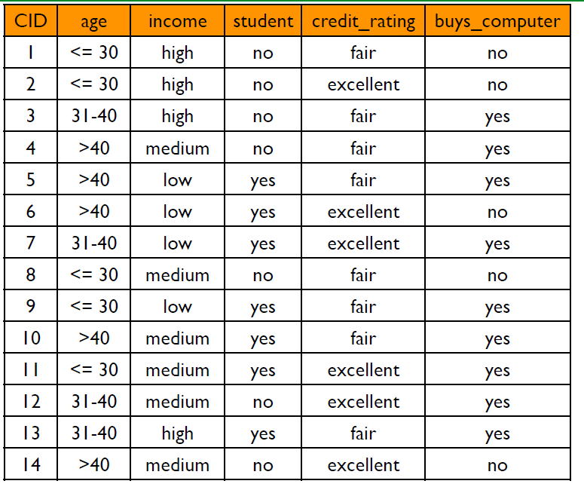
Example: Training Set
Ravi Starzl, PhD - Data Mining Fall 2023
Notes:
In decision tree induction, the training set plays a pivotal role. Examining a sample data table can illuminate the structure and importance of its features in this context.
Consider a simplified customer behavior dataset table. This dataset has five attributes: age, income, student status, credit rating, and a decision on purchasing a computer. Each row, barring the first, denotes an instance or record, which is an individual observation of the subject in question. The primary goal using this dataset is to predict the outcome in the "Buys Computer" column based on the other attributes.
Within decision tree induction, the "Buys Computer" column is termed the target attribute, as it's the attribute being predicted. The remaining attributes are known as predictor attributes. The methodology of decision tree induction involves utilizing the predictor attributes to segment the data into subsets that uniformly align with the target attribute.
the 'age' attribute classifies customers into three groups: those 30 years or younger, those between 31 and 40 years, and those older than 40. Such classifications are integral to the decision-making mechanism since a customer's age may correlate with their inclination to purchase a computer.
the 'income' attribute can be employed to assess if a customer's income tier influences their purchasing decision. The 'student' and 'credit rating' attributes provide further context, potentially shedding light on a customer's financial stability, which could influence their buying choices.

Slide 9
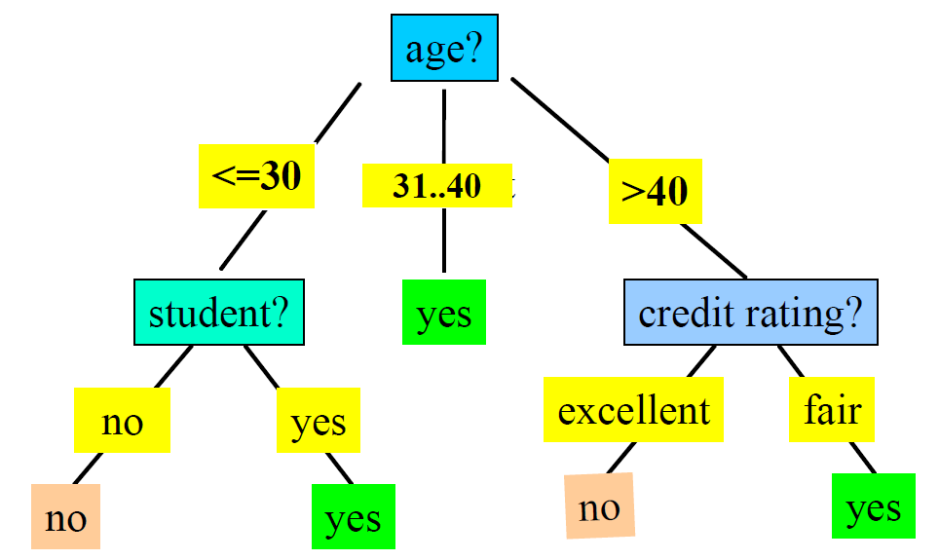
Example: Decision Tree
Ravi Starzl, PhD - Data Mining Fall 2023
Notes:
Decision Trees offer a clear framework for classification. Let's examine a sample decision tree to elucidate its structure and interpretation.
A decision tree can be visualized as a flowchart where each internal node signifies an attribute, each branch denotes a decision rule, and each leaf node indicates an outcome.
The tree originates from a root node (Node 0) labeled 'age?'. The appended question mark signifies that this node represents a decision based on the 'age' attribute. The tree subsequently branches into three nodes (Node 0-1, Node 0-2, Node 0-3) that delineate distinct age categories.
Navigating the tree's branches leads to subsequent decision points or to the final outcome. For instance, Node 0-1, corresponding to ages 30 or below, directs to Node 1-4 labeled 'student?', indicating another decision point. Nodes such as Node 2-5 and Node 8-12, labeled 'yes', are leaf nodes signifying an outcome. In this tree's context, the path taken predicts that the individual will opt to purchase a computer.
Considering a decision path in detail, starting from the 'age?' root node and selecting Node 0-3 ('>40'), the next node is Node 3-6 ('credit rating?'). Choosing Node 6-9 ('excellent') leads to Node 9-13, labeled 'no'. This path suggests that an individual over 40 with an excellent credit rating is not anticipated to purchase a computer, as per the decision tree.

Slide 10

Decision Tree Induction
Basic algorithm (a greedy algorithm)
top-down, recursive, divide-and-conquer
attribute selection
attribute split
Ravi Starzl, PhD - Data Mining Fall 2023
Notes:
Decision tree construction is based on inductive learning, which focuses on discerning patterns from data.
The core process involves the decision tree induction algorithm, a type of greedy algorithm. Such algorithms optimize decisions at each stage, anticipating that these decisions cumulatively lead to an optimal solution.
In constructing the tree, a top-down, recursive, and divide-and-conquer strategy is employed. Beginning at the tree's root, the data is split recursively, creating smaller subsets. This partitioning persists until specific criteria are met, like all instances in a subset being of a singular class or reaching the tree's predetermined depth.
The divide-and-conquer strategy segments a large problem into smaller, solvable challenges. Each challenge is resolved individually, with the collective results forming the solution to the initial problem.
A decision during this process is determining the appropriate splitting points. This decision hinges on attribute selection measures, heuristics designed to optimally partition data. These measures aim to identify attributes that most effectively segregate tuples into distinct classes.
Several attribute selection measures are available, encompassing Information Gain, Gain Ratio, and Gini Index. For instance, Information Gain leverages entropy, a metric of impurity or randomness. The attribute yielding the highest information gain is selected for splitting.
In assessing attributes for splits, each attribute undergoes a statistical evaluation to gauge its classification efficacy for the training examples. The most effective attribute is then designated as the test at the root node.
Consider an 'Income' attribute with categories: 'High', 'Medium', and 'Low'. Each category initiates a distinct branch. It's noteworthy that not all divisions are binary in nature. Continuous attributes, like 'Age', might be segmented into defined ranges, such as 'Young', 'Middle-aged', and 'Old'.
The algorithm's greedy nature stems from its focus on the best current decision, without revisiting or revising prior decisions.

Slide 11
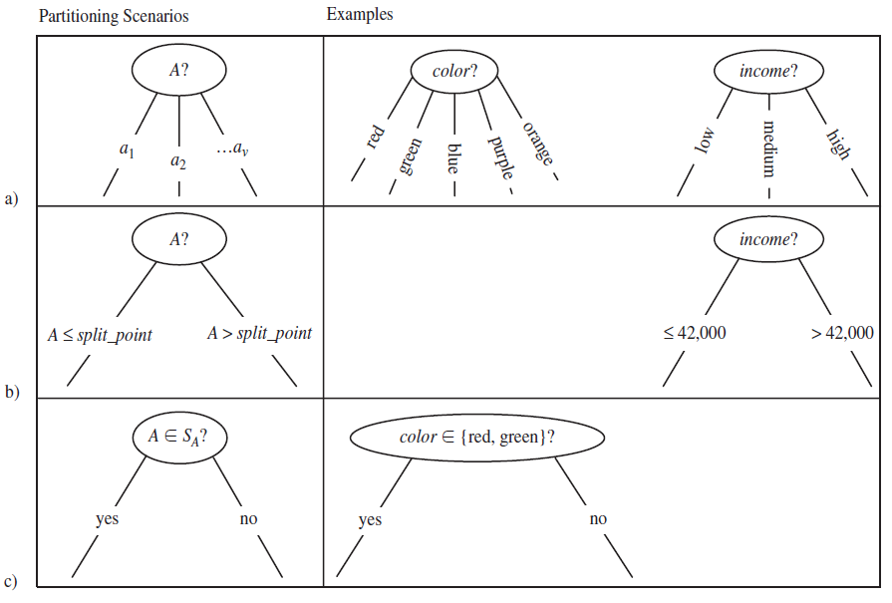
Splitting Attributes
a) Discrete-values Directly
b) Continuous-valued:
split_point
c) Discrete-valued:
binary tree,
splitting_ subset
Ravi Starzl, PhD - Data Mining Fall 2023
Notes:
In decision tree induction, selecting splitting attributes is a key step. Three scenarios highlight varied approaches to splitting based on different types of attributes.
For Discrete-Values Directly, an attribute such as 'Color' with categories 'Red', 'Green', and 'Blue' has each category act as a split point. This results in three distinct branches, with each directing data corresponding to a specific color category.
Continuous-Valued attributes like 'Age' or 'Income' require a different approach. Instead of creating a branch for every possible value, a split point is determined to optimally separate the data. With 'Age' as the attribute, a split could be set at 30, leading to two branches: 'Age<=30' and 'Age>30'. The optimal split point is identified using techniques that maximize information gain or reduce impurity.
In cases with Discrete-Valued attributes that need a binary tree representation, a splitting subset method is employed. This is particularly useful when the count of discrete values is high. Taking 'Occupation' as an attribute with multiple professions, a binary split can be established by categorizing professions into 'Tech-related' and 'Non-tech-related', with each subset corresponding to a separate branch.
The accompanying figure showcases these partitioning scenarios:
a) Direct partitioning on discrete values results in multiple branches from each node.
b) A split point for continuous valued variables segregates the data into two groups.
c) A binary tree or splitting subsets for discrete valued variables enhances tree simplicity.
Attribute splitting, based on the attribute type, plays a determining role in the decision tree's efficacy and clarity.

Slide 12

Decision Tree Induction
Basic algorithm (a greedy algorithm)
top-down, recursive, divide-and-conquer
attribute selection
attribute split
Stopping conditions
all samples belong to the same class
no remaining attributes: majority voting
no samples left
Ravi Starzl, PhD - Data Mining Fall 2023
Notes:
Decision tree induction utilizes a basic algorithm characterized by its greedy approach. This approach operates without backtracking. The algorithm initiates at the tree's root, building the tree recursively by opting for the locally optimal choice at every step. This top-down method starts with the complete dataset and incrementally refines the subsets while moving down the tree, a methodology termed 'divide-and-conquer.'
Following this, attribute selection is conducted. The goal is to identify an attribute that effectively divides the samples into distinct classes. The criterion for "best" is often determined using impurity measures such as the Gini Index or entropy-based Information Gain. The attribute showcasing the highest value (or the lowest impurity) is selected to bifurcate the dataset at each node.
Subsequent to attribute selection, data is partitioned based on the values of the chosen attribute. This partitioning can entail direct bifurcation for discrete values, pinpointing a split point for continuous values, or instituting binary trees for discrete values with numerous categories.
A vital aspect of decision tree induction is recognizing the Stopping Conditions, which dictate when to cease the tree-building endeavor. Three scenarios serve as indicators:
1. Uniformity of samples in a node, indicating that all belong to an identical class, rendering the node completely pure.
2. Absence of available attributes for further splits. In situations where diverse class samples reside within a node, the prevalent class, determined by majority voting, is assigned as the node's class.
3. An absence of samples to further partition. Occasionally, specific attributes result in unpopulated branches. Typically, the most frequent class of samples from the parent node is allocated to such branches.
In essence, decision tree induction offers a structured method to develop a model. This model predicts class outcomes by discerning decision rules from existing features.

Slide 13
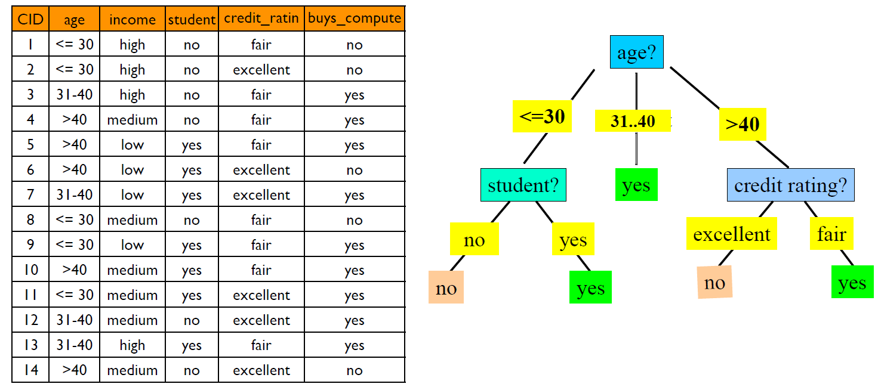
Example: Training Set & Decision Tree
Ravi Starzl, PhD - Data Mining Fall 2023
Notes:
Let's take an illustrative training dataset containing attributes like Age, Job, Credit Score, and Loan Default.
Attribute selection is the initial phase in this construction. An attribute is chosen that efficiently divides the samples into clear classes. For instance, 'Credit Score' might be the optimal attribute to start the tree. Determining this optimal attribute can involve statistical methods such as the Gini Index or Information Gain.
Following attribute selection, the dataset is partitioned based on the chosen attribute. In this scenario, 'Credit Score' would lead to branches such as 'low', 'medium', and 'high'.
The subsequent step is to further refine each subset by repeating the process: choosing the best attribute for the subset and dividing it accordingly. For instance, the branch representing a 'low credit score' could be further divided based on the 'Job' attribute, resulting in 'permanent' and 'contractual' branches.
The recursive partitioning stops when:
- All samples in a node are of the same class, indicating either all have defaulted on a loan or none have.
- No attributes remain for further division, in which case majority voting determines the node's class.
- No samples are available for further splitting.
The tree is constructed from top to bottom, recursively segmenting the data based on selected attributes. This method exemplifies the divide-and-conquer strategy, with each tree level producing a more detailed segmentation of the dataset.
The overarching goal is to produce a tree that can accurately classify unfamiliar data while maintaining simplicity. Overly intricate trees can overfit to the training data, resulting in suboptimal performance on new data. To address this, pruning techniques can be employed.

Slide 14
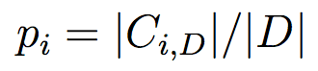
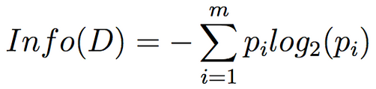
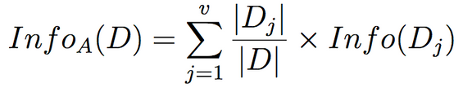
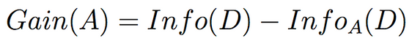
Attribute Selection Measures
Information gain (ID3/C4.5)
D, m classes Ci
expected information (entropy) needed to classify D
information needed to classify D using A
attribute A: a1, a2, ..., av
information gain
Ravi Starzl, PhD - Data Mining Fall 2023
Notes:
Decision tree induction uses attribute selection measures to decide the sequence in which attributes are used to split the data. Among these measures, Information Gain is commonly employed, especially in algorithms like ID3 and C4.5.
Information Gain gauges how much a particular attribute reduces the randomness or disorder (known as entropy) in the data. The objective is to produce subsets where the values of the target variable are more uniform or less scattered.
Entropy is a concept that quantifies the unpredictability or uncertainty in classifying a dataset. It is at its highest when the classes in the dataset are equally distributed and is at its lowest when all instances belong to a single class.
Another measure, "Expected Information Given the Attribute", calculates the average amount of information needed to classify the dataset using a specific attribute. This measure takes into account the size of each subset created by the attribute.
Information Gain, measures the difference between the dataset's entropy and the weighted average entropy after using an attribute to segment the dataset. In simple terms, it's a measure of how effective an attribute is in classifying the data. The attribute with the highest information gain is typically chosen to make the decision.
In decision tree algorithms, the aim is to minimize entropy or maximize information gain to create the most efficient splits. This process ensures that the model can predict outcomes with greater accuracy. Both entropy and information gain play a central role in shaping decision trees and determining their classification accuracy.

Slide 15
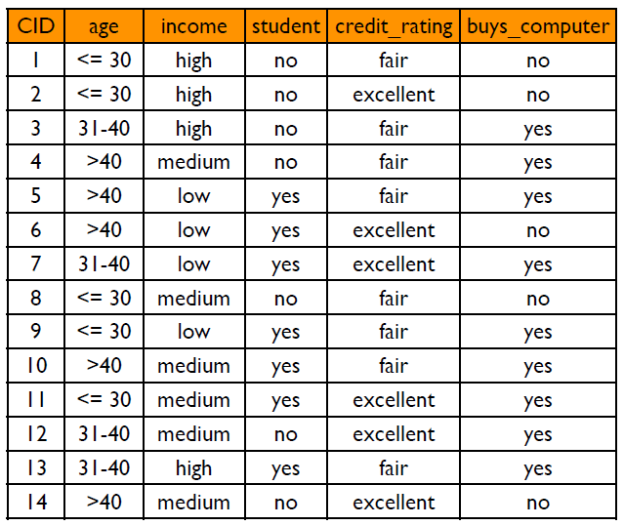
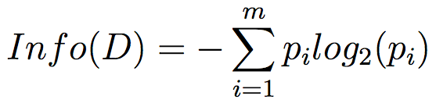
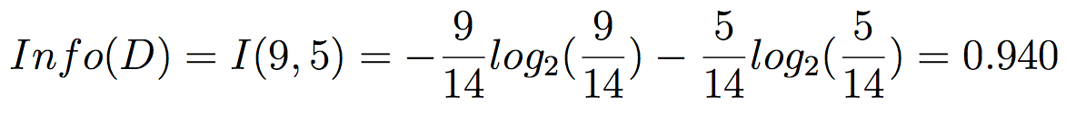
Information Gain Example
Two classes
buy: 9
not buy: 5
total: 14
Ravi Starzl, PhD - Data Mining Fall 2023
Notes:
Decision tree induction often requires determining the expected information needed to classify instances within a dataset, D. For illustration, imagine dataset D has 14 instances divided into two classes: "buy" with 9 instances and "not buy" with 5 instances. The goal is to ascertain how much information is required to classify an instance in D.
To achieve this, the entropy of dataset D is determined. Entropy, denoted as Info(D), quantifies the unpredictability or randomness of set D. The entropy involves the proportion of instances in each class, combined with a logarithmic function that measures disorder.
For the given dataset, the proportion of "buy" instances is 9/14, and for "not buy" instances, it's 5/14. These proportions are utilized in the logarithmic portion of the entropy computation, representing the level of unpredictability associated with each class. The result of this computation offers the average amount of information required to discern whether a customer will "buy" or "not buy".
The computed value of Info(D) stands at approximately 0.94. Interpreting this, approximately 0.94 "bits" of information are needed to classify a customer's intent in this dataset.
In classifying data, a classification with lower unpredictability (or higher uniformity) will yield a reduced entropy value. By evaluating the information gain, which is the difference between entropies, one can make an informed decision regarding which attribute will most effectively aid in accurate prediction.

Slide 16
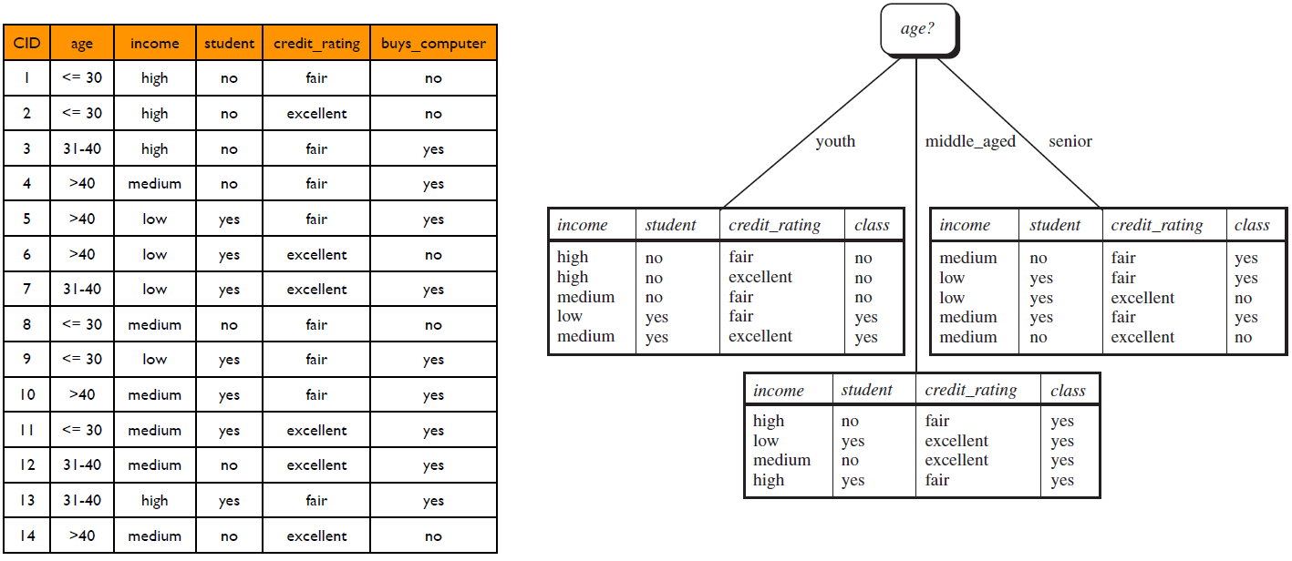
Information Gain Example
Ravi Starzl, PhD - Data Mining Fall 2023
Notes:
A decision tree resembles a flowchart where each internal node signifies a test on an attribute, branches correspond to the test's outcome, and each leaf node contains a class label. The paths from root to leaf dictate classification rules.
Using a dataset with customer data attributes like "age", "income", "student status", and a target variable "buys_computer" can help illustrate how a decision tree is formed. Focusing on the "age" attribute, it's split into three categories: age < 30, age between 31 and 40, and age > 40, based on data analysis indicating varying computer-buying behaviors across these age groups.
The resulting decision tree has "age" as its root node with three branches, each for an age category.
Traversing the tree:
- Data instances with age < 30 follow the left branch, leading to further conditions and eventually a leaf node indicating the most likely class for this age group.
- Instances with age between 31 and 40 use the middle branch, again ending at a leaf node indicating the most likely class for this category.
- Data with age > 40 use the right branch, leading to its respective leaf node and class prediction.
Decision trees offer clear visualization and straightforward decision paths, making them easily interpretable. The construction process prioritizes attributes offering the highest information gain, and tree growth continues until nodes are pure or other stopping criteria are met.

Slide 17
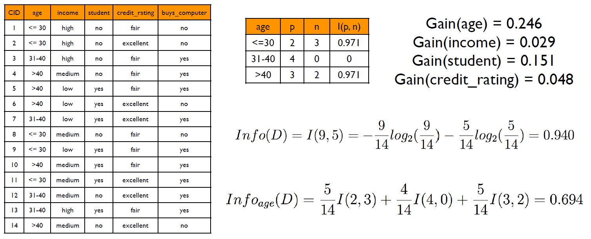
Information Gain Example
Ravi Starzl, PhD - Data Mining Fall 2023
Notes:
A decision tree employs information gain to determine the order in which attributes are selected for splitting data. The objective is to quantify the information gain for each attribute in relation to the target variable.
To understand this, the expected information, denoted as Info(D), required to classify a tuple in dataset D is computed. In the given dataset, D comprises 14 tuples with 9 labeled "buy" and 5 labeled "not buy". Info(D) represents the average information necessary to identify a tuple's class label in D. To determine this value, the entropy or expected information for specific classes, like "buy" and "not buy", is calculated. The proportions 9/14 and 5/14 represent the probabilities of "buy" and "not buy" classes, respectively. The logarithmic term offers a measure of information, and its negative sign ensures that the value remains positive.
For attribute-based partitioning, the "age" attribute is taken as an example, which divides D into three subsets: age < 30, age between 31 and 40, and age > 40. The distribution for age < 30 includes 2 "buys" and 3 "not buys"; age between 31 and 40 has 4 "buys"; and age > 40 consists of 3 "buys" and 2 "not buys". By applying the entropy function to these partitions, the expected information based on the "age" partitioning, denoted as Infoage, is derived. The fractions within this calculation indicate the proportion of instances within each "age" partition.
The difference between Info(D) and Infoage yields the information gain. This gain, represented as Gain(D, age), is the reduction in expected information achieved by understanding the "age" attribute value. In this example, the gain is 0.246, implying that the "age" attribute provides substantial insight when predicting a customer's purchasing decision.
Attributes with the highest information gain are favored as decision nodes during decision tree construction.

Slide 18

Information Gain
Continuous-valued attribute A
Determine the best split point for A
sort A values in increasing order
consider the midpoint of adjacent values: (ai + ai+1) / 2
pick the midpoint w/ minimum InfoA(D)
Split: D1: A <= split point; D2: A > split point
Ravi Starzl, PhD - Data Mining Fall 2023
Notes:
Decision trees are capable of handling continuous-valued attributes. These attributes differ from discrete ones as they can take on a myriad of values within a range. To incorporate them into the decision tree structure, it's common to convert continuous attributes into a discrete format.
Here's a breakdown of the process using attribute A as an example:
1. Arrange the values of attribute A in ascending order. This gives a clear sequence for analysis.
2. Identify midpoints between each adjacent pair of values. These midpoints serve as potential points to partition the attribute.
3. From the identified midpoints, select the one that results in the least expected information requirement for attribute A. The goal is to find the split that offers the most information gain.
4. With the chosen split point, divide the data into two subsets: one with values of A less or equal to the split point, and the other with values greater than the split point.
To illustrate, consider a hypothetical set of values for attribute A:
- When arranged in order, the values are 1, 2, 3, 4, 5.
- Potential midpoints between these values are 1.5, 2.5, 3.5, and 4.5.
- After assessing each midpoint, let's assume 2.5 is found to be the most effective in reducing the expected information requirement.
- Consequently, the optimal division for A occurs at 2.5, creating two groups: one with values up to 2.5 and another with values greater than 2.5.

Slide 19

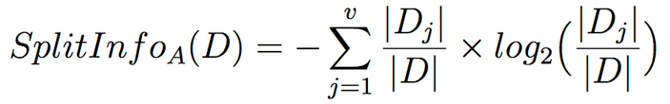
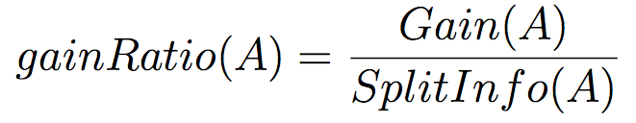
Gain Ratio (C4.5)
Information gain measure biased towards attributes
with a large number of values
e.g., customerID, productID
C4.5 (a successor of ID3)
select attribute with maximum gain ratio
Ravi Starzl, PhD - Data Mining Fall 2023
Notes:
Decision trees often rely on Information Gain to select attributes. However, this method can be biased towards attributes with many values, such as 'customerID' or 'productID'. Although these attributes might lead to perfect splits, they can overfit and lack broad applicability for prediction. To address this bias, the Gain Ratio was introduced.
The Gain Ratio, used in the C4.5 algorithm, adjusts Information Gain to account for the number of splits an attribute can produce. It achieves this adjustment with the concept of Split Information, represented as SplitInfoA(D). The Split Information acts as a normalization factor.
In the Split Information equation, the ratio |Dj|/|D| indicates the proportion of examples in a given subset. This ratio signifies the probability of a data point in D belonging to subset Dj when divided by attribute A. The logarithmic component quantifies the information for each potential outcome, while the summation considers all possible values of attribute A. The negative sign ensures the outcome remains positive, aligning with information theory conventions.
Split Information offers insight into the information created by categorizing dataset D based on attribute A. Splits that result in uniform subsets have lower Split Information, whereas those leading to mixed-class subsets have higher values.
The Gain Ratio modifies the Information Gain using Split Information. This adjustment provides a more nuanced attribute selection criteria. It simultaneously evaluates the quality and potential information of a split, thus mitigating the preference for attributes with numerous values.

Slide 20
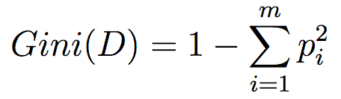
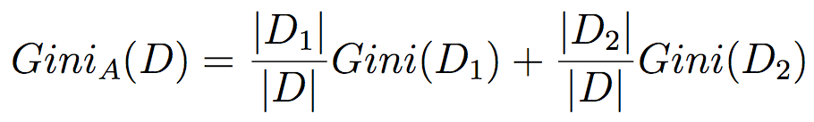
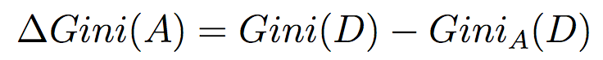
Gini index
Gini Index (CART)
Binary split using attribute A
Reduction in impurity
Select attribute with largest impurity reduction
Ravi Starzl, PhD - Data Mining Fall 2023
Notes:
The Gini Index, in conjunction with the CART (Classification and Regression Trees) method, provides an alternative approach to decision tree creation. Unlike the C4.5 algorithm, which may produce multiple branches from a node, CART strictly adheres to binary splits, resulting in two child nodes from each parent node.
Central to the CART methodology is the Gini Index, a metric that quantifies node impurity. A node achieves complete purity when all its contained samples are from a single class. Conversely, the impurity peaks when there's an equal distribution of samples across various classes.
To determine the Gini Index for a node, one evaluates the proportion of samples associated with each class within that node. The cumulative effect of these proportions, when squared and summed, provides insight into the node's uniformity. The Gini Index is then derived by subtracting this value from one, thus measuring the degree of impurity.
When initiating a binary split on an attribute, the Gini Index for the resultant datasets is computed. This is achieved by weighting the Gini Index of each subset by its relative size to the original dataset. The combined value represents the total Gini Index for the division.
An integral aspect of CART is assessing the impurity reduction resulting from the split. This is gauged by contrasting the Gini Index of the original node with that of the split. The attribute yielding the highest reduction in impurity is chosen for the division.
The underlying principle of CART is to continually enhance the uniformity of the subsequent child nodes. This methodology aspires to create decision trees that categorize training data proficiently.
The Gini Index and CART methodology furnish a distinct paradigm for decision tree generation. It emphasizes binary partitioning and prioritizes the decline of impurity at every division. This might yield tree configurations that diverge from those generated by algorithms like C4.5. Each method possesses inherent advantages, making them more suited to specific scenarios.

Slide 21
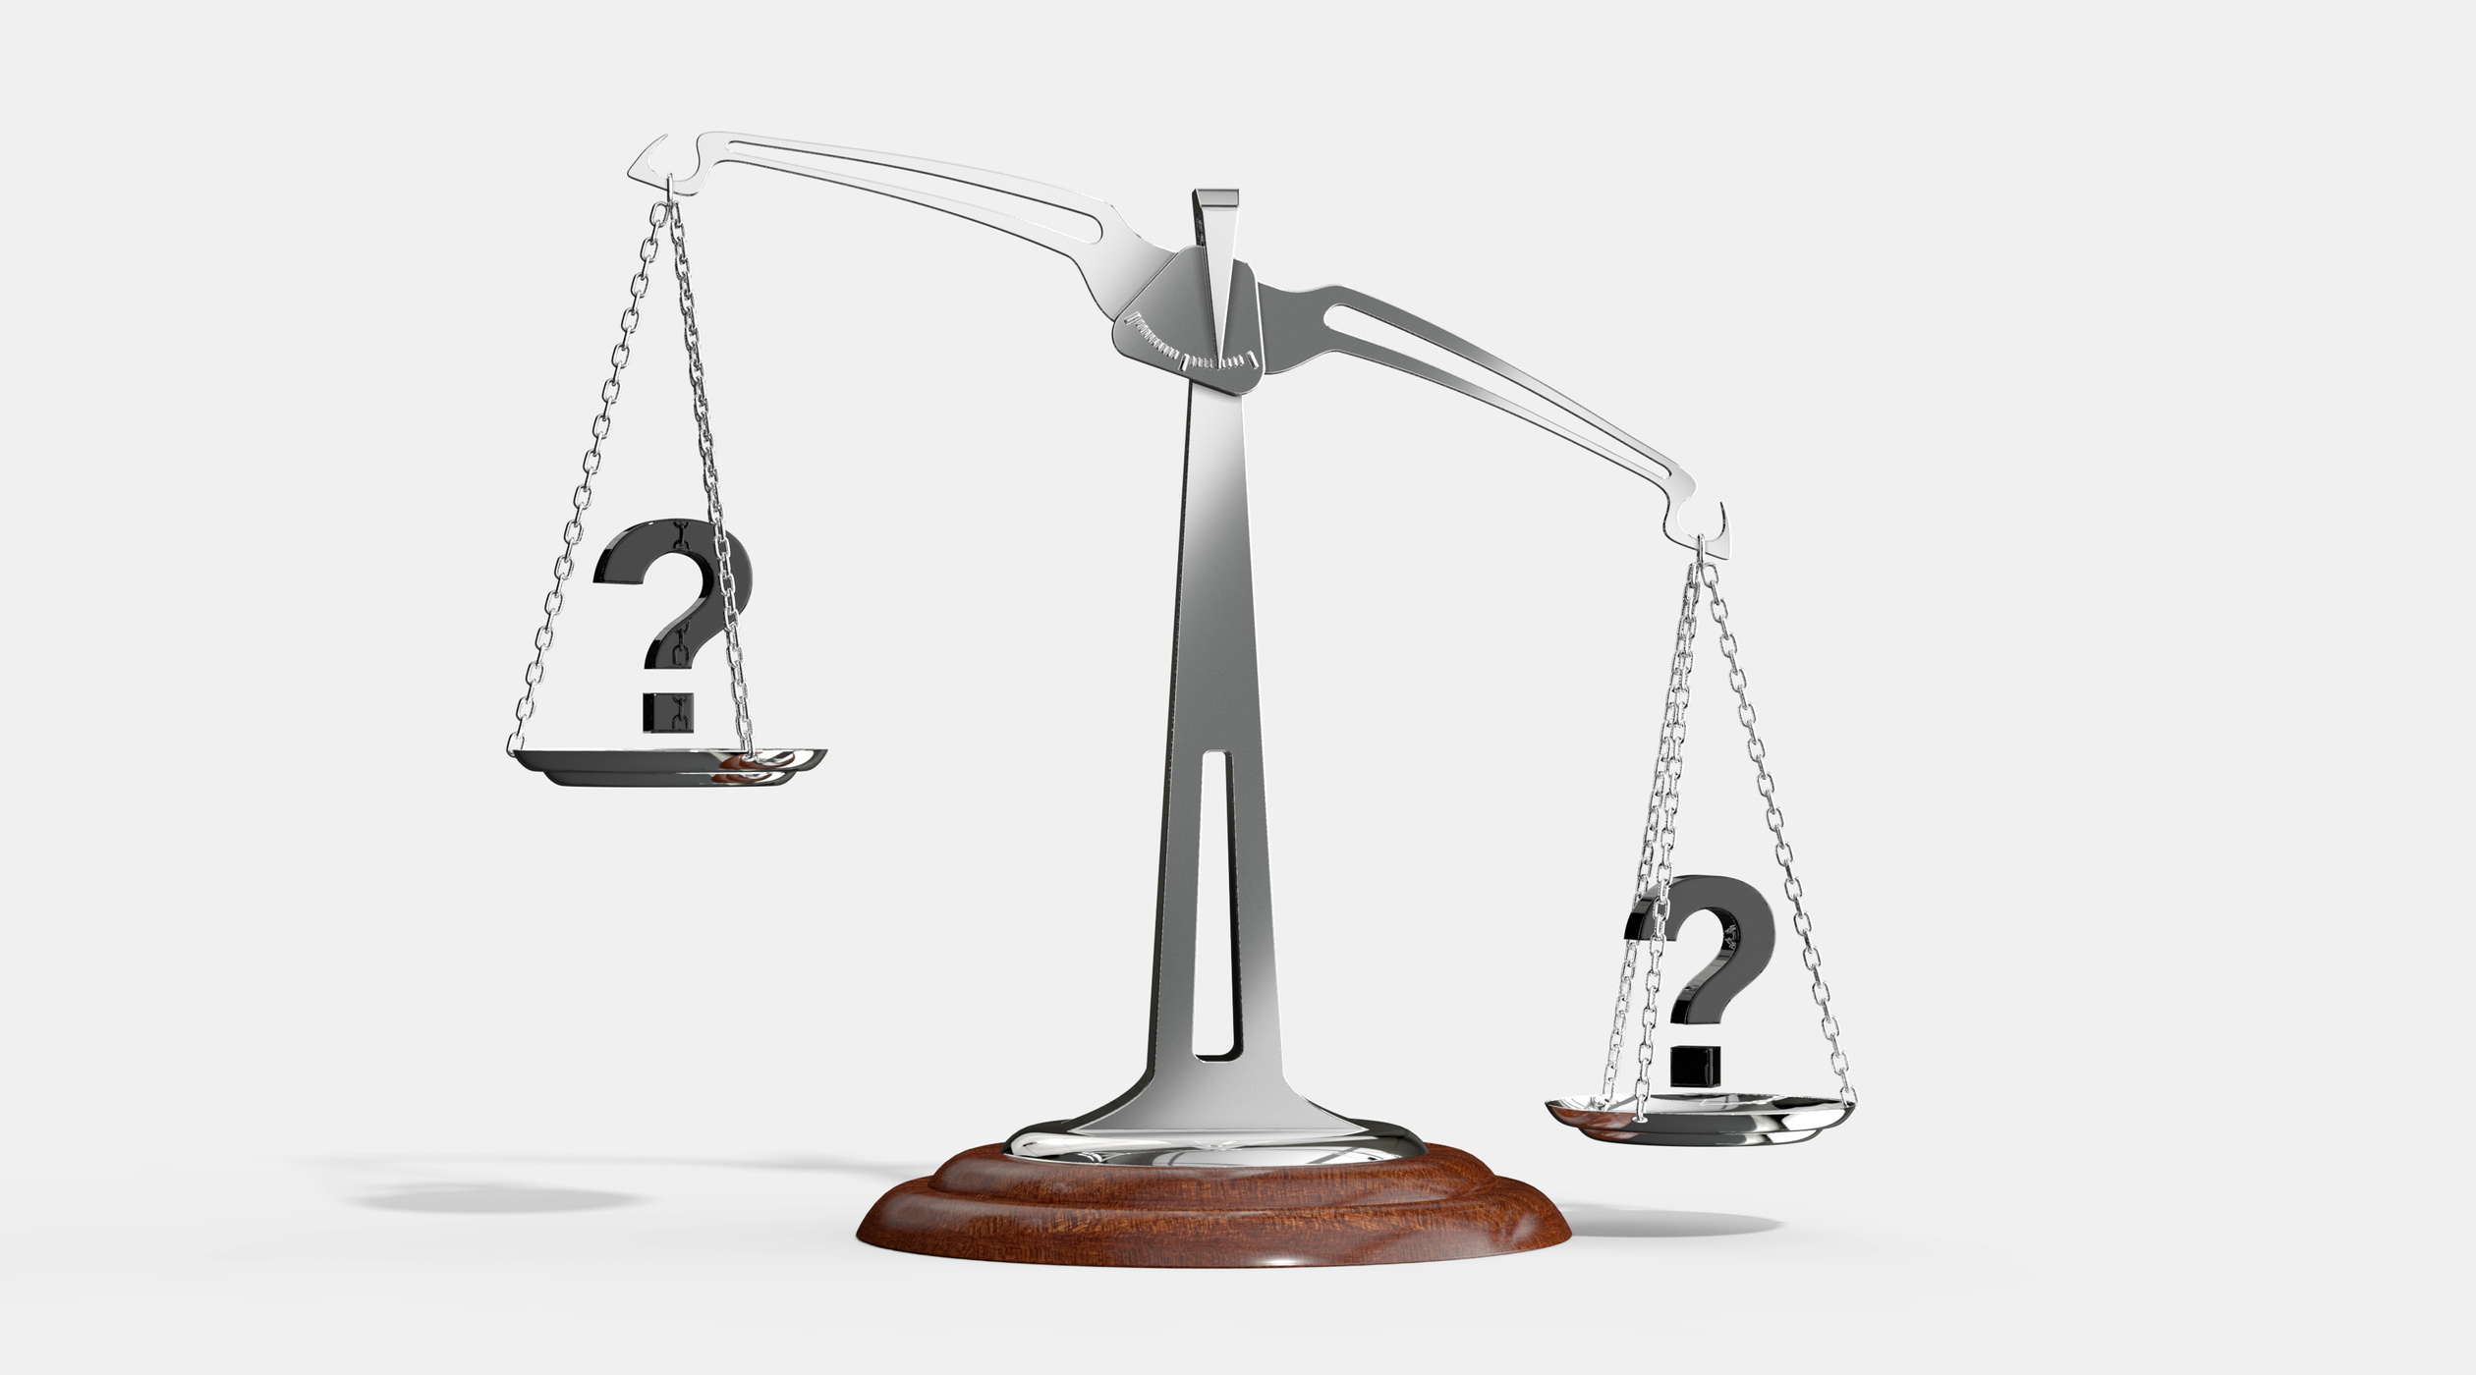
Attribute Selection Measures
Comparison of the three measures
good results in general but some biases
information gain: multi-valued attributes
gain ratio: unbalanced splits
gini index: multi-valued, equal-sized & pure partitions, not good when number of classes is large
Ravi Starzl, PhD - Data Mining Fall 2023
Notes:
Information Gain, Gain Ratio, and the Gini Index are three measures used in decision tree algorithms. Each has its biases and properties that make it suitable for certain scenarios.
Information Gain, used in ID3 and C4.5 algorithms, has a bias towards multi-valued attributes. Attributes like 'customerID', which have unique values for each data entry, can result in high Information Gain. Such attributes can lead to overfitting, as they might classify the training set perfectly but might not generalize well to unseen data.
Gain Ratio, derived from Information Gain and employed in the C4.5 algorithm, addresses the bias of Information Gain by introducing a normalization factor called Split Information. However, Gain Ratio has its own bias. It tends to prefer splits where one subset is much smaller than the other, which may not always yield the most informative partitions.
On the other hand, the Gini Index, used in the CART algorithm, measures node impurity and seeks to minimize the chance of misclassification. It tends to favor attributes that result in equal-sized partitions. One limitation is that it might not be as effective when there are many classes or when partitions are highly pure. Another constraint is its handling of continuous attributes, which need to be discretized.
Given their respective biases, no single measure is universally ideal. Their effectiveness is influenced by the dataset's characteristics. For example, datasets with numerous multi-valued attributes might benefit from using the Gini Index or Gain Ratio, while datasets with fewer multi-valued attributes might be more suited for Information Gain.

Slide 22

Overfitting & Tree Pruning
Overfitting of the training data
too many branches, reflect anomalies due to noise or outliers
poor accuracy for unseen data
Tree pruning to avoid overfitting
preprunning: halt tree construction early
postpruning: remove branches from a “fully-grown” tree
Ravi Starzl, PhD - Data Mining Fall 2023
Notes:
Overfitting in decision tree models arises when the model becomes too detailed or complex. This complexity may cause the model to capture noise or anomalies in the training data, leading to high accuracy on the training set but poor performance on unseen data.
Tree pruning is a technique employed to address overfitting by simplifying the decision tree. The goal is to make the model more generalized, which can improve its performance on new data.
There are two primary types of tree pruning: prepruning and postpruning.
Prepruning stops the growth of the tree prematurely. Criteria such as a minimum threshold of instances or a set limit on information gain can be used to decide when to halt. By not allowing the tree to become overly detailed, prepruning can prevent the model from capturing noise in the training data.
Postpruning, in contrast, begins with the construction of a full decision tree. Afterward, the tree's branches are trimmed in a bottom-up manner using a validation set. Branches are removed if their elimination results in better or comparably good performance on the validation set.
While prepruning can be more efficient by avoiding the creation of a full tree, postpruning can lead to more accurate models since it evaluates the entire tree before making reductions.
Selecting between prepruning and postpruning depends on the specific problem and available resources. Regardless of the method chosen, the primary objective remains to minimize overfitting and enhance the model's ability to generalize to new data.

Slide 23
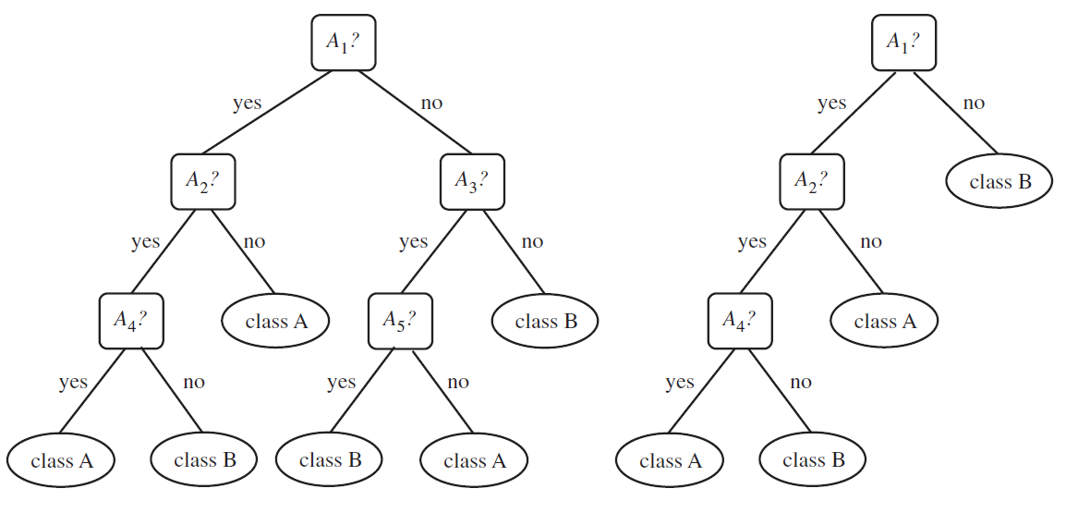
Tree Pruning Example
Replace a subtree w/ most freq. class label
Ravi Starzl, PhD - Data Mining Fall 2023
Notes:
Overfitting in decision tree models can arise from excessive complexity, where the tree captures noise or irregularities in the training data. One approach to simplify such models and enhance their generalization is the replacement of a subtree with its most frequent class label.
In a given decision tree, there might be a branch under the root node that is particularly complex and detailed. If this branch tends to overfit because of its intricacy, it can be replaced with a single node that represents the most frequent class label of the instances within that branch. This action reduces the depth and complexity of the tree.
This replacement strategy offers several advantages in data mining. It streamlines the model by reducing the number of decision rules, making the tree easier to interpret and leading to quicker decision-making. While there might be a slight decrease in accuracy, the benefits of a more straightforward model often justify this trade-off.
Consider a scenario where a decision tree predicts customer churn based on various attributes like usage pattern, plan details, and customer interactions. One of the tree's branches, which segments customers based on intricate aspects of their usage pattern, might be long and detailed. However, if most instances within this branch belong to the 'Stay' class, the entire branch can be replaced with a single 'Stay' label. This replacement means that under certain conditions, the customer is most likely to remain, eliminating the need for multiple decision nodes and conditions within that branch.

Slide 24
Basic concepts of classification
Classification vs prediction
Supervised vs unsupervised
Evaluation criteria
Decision tree induction
Splitting attributes
Top-down basic greedy algorithm
Stopping conditions
Information gain
Gain ratio
Gini index (CART)
Overfitting and tree pruning
Summary
Ravi Starzl, PhD - Data Mining Fall 2023

Slide 25
Thank you
A special thank you to Qin Lv for her slides, on which this lecture is based
Ravi Starzl, PhD - Data Mining Fall 2023

